Slide 1
Computational Sciences Research at Army Research Laboratory
Dr. Raju Namburu

Slide 2


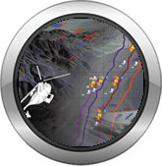

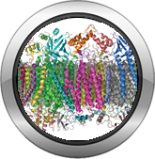




U.S. Army Research Laboratory
Mission
DISCOVER, INNOVATE, and TRANSITION Science and Technology to ensure dominant strategic land power
Information Sciences
Analysis & Assessment
Computational Sciences
Extramural Basic Research
Vision
The Nation’s Premier Laboratory for Land Forces.
Sciences for Lethality & Protection
Sciences for Maneuver
Materials Research
Human Sciences
Making today’s Army and the next Army obsolete

Slide 3



ARL Central
Under Development
Advanced Photon Source
CRA - Cyber Security
Research Alliance
Old Main State College, PA
ARO-London
co-located with
RFEC-ATLANTIC
ARO-Tokyo
co-located with
RFEC-PACIFIC
ARL North East
Under Development
ISN - Cambridge, MA
CTA - Network Sciences
Cambridge, MA
ARL - Aberdeen Proving Ground
CRA - Multi-Scale Multidisciplinary Modeling of Electronic Materials
Salt Lake City, Utah
ARL - Adelphi Laboratory Center (HQ)
CRA - Materials in Extreme Dynamic Environments
Baltimore, Maryland
ICB - Santa Barbara, CA
CTA - Micro Autonomous Systems and Technology (MAST)
Washington, D.C.
Playa Vista, CA
ARL West
CTA - Robotics
Falls Church, VA
ICT - Playa Vista, CA
White Sands Missile Range
CTA - Cognition & Neuroergonomics
Alexandria, VA
ARL Primary Labs Site
ARL Field Element
Collaborative Alliances
Open Campus Hub
Collaboration Spoke
International Hub
ARO-Brazil
co-located with
RFEC-AMERICAS
ARL - Orlando, FL
ARL – ARO- RTP, NC
ARL South
Austin, TX

Slide 4
Talented Workforce
Electrical/Electronics Engineer
21% (285)
Computer Scientist/Engineer 13% (197)
S&E Degree Distribution
Physicist/Physical
Scientist
13% (181)
Scientists and Engineers – 75% (1380)
Bachelors
24%
Doctorate
44%
Contractors – 39% (1205)
Admin and Support
17% (283)
Masters
32%
Civilians – 60% (1849)
Military
1% (29)
3083Total Workforce
(as of 30 SEPT 2016)
Chemist/Chemical
Engineer
7% (97)
Increased civilian S&Es with PhDs from 434 to 603 (FY06-FY16)
General/Industrial
Engineer
6% (82)
Materials Engineer
6% (82)
Civ Intel & Security
2% (27)
Aerospace Engineer 3% (47)
Operations Research Analyst 3% (40)
Technicians
8% (127)
Physiologist 3% (38)
Biologist/Biomedical Engineer 3% (37)
Mathematicians/Statisticians 2% (31)
Engineering Psychologist 1% (20)
Neuroscientists 1% (14)
Meteorologist 1% (13)
Others –1% (18)

Slide 5

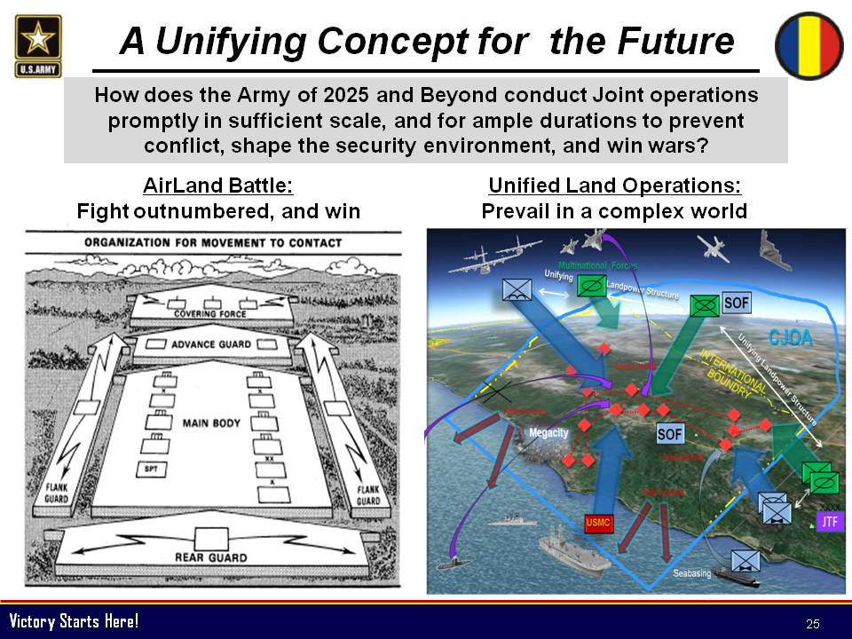
TRADOC Unifying
Concept for the Future
AirLand Battle:
Flight outnumbered, and win
Unified Land Operations:
Prevail in a complex world
ARL’s S&T Strategy- Perform fundamental research to inform the Army Operating Concept for the “Deep Future” (2050)
Notes:
Army acknowledges complexity of future battlespace and is working to transition it’s operational future vision.
This event horizon for kinetic activity becomes murky and actors become increasingly gray (viz red/blue).
Bits: cyber attack
Bots: uninhabited & autonomous agents will attempt to degrade capabilities
Bodies: will enter an increasingly sky/night/spectrum/geographically-denied environments

Slide 6
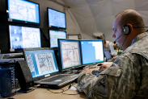

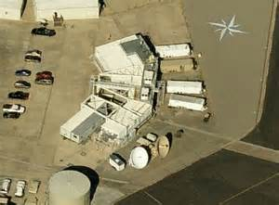
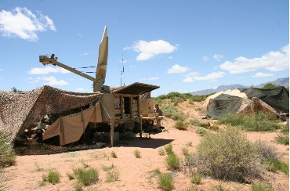














(U) Command Post Computing Environment
(U) Systems View
Intel
Analytics
Diagram is: (U)
Home Station
Above
Tactical Data
Center
Strategic Enterprise
CORP &
Regional
Intel
Apps/Widgets
Large CP
Server
V
Division
Data Services and
Remote Synch
Implementation
Server
V
Brigade
Small CP
Tactical Enterprise
Battalion
Simplified CP
En Route CP
Tactical Server
Infrastructure
Company
Intel
Apps/Widgets
Intel
Analytics
Solider Computing Environment
Mission Cmd
Apps/Widgets
Mission Cmd
Analytics
Platoon
(U) Data services broker communication between applications internal to a device
(U) Local ad-hoc discovery and data distribution between clients utilizing common core infrastructure
(U) Configured Remote Synch between instances of core infrastructure
Vehicle
Soldier
Mission Cmd
Apps/Widgets
Lower Tactical
Enterprise
Solider Computing Environment
(U) Smart Client
(U) Web Client
Diagram is: (U)

Slide 7
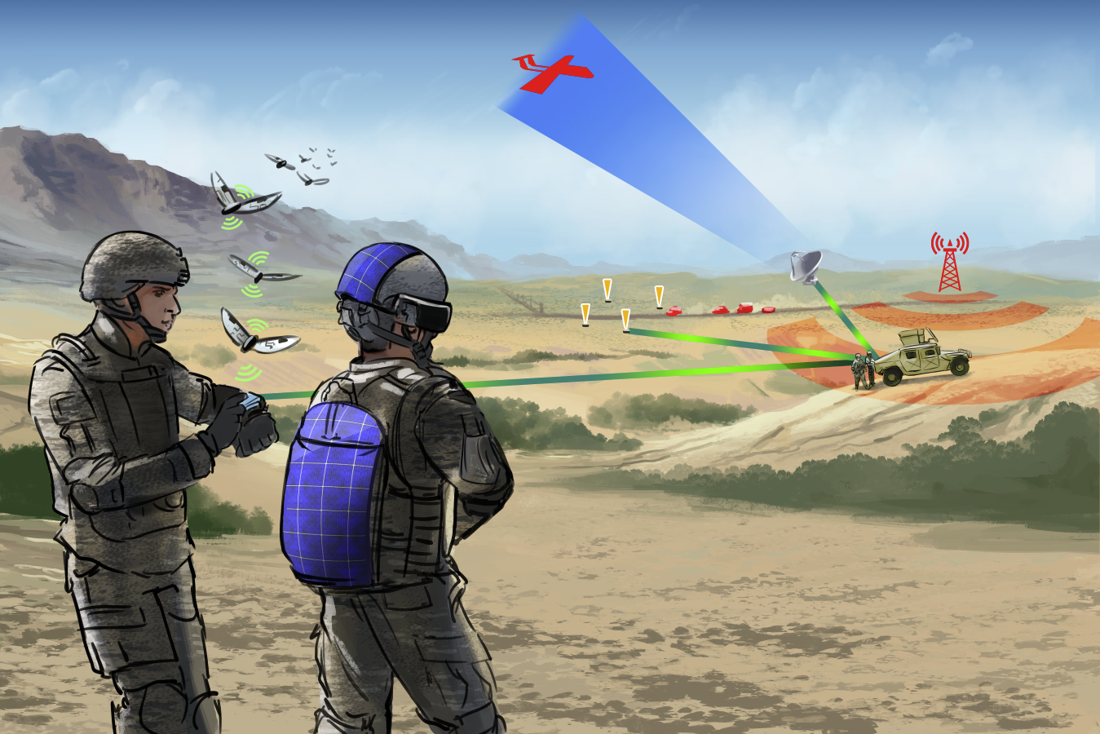

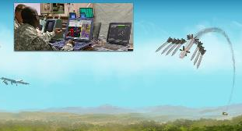
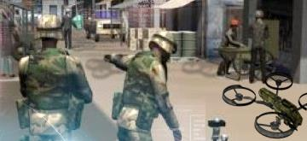
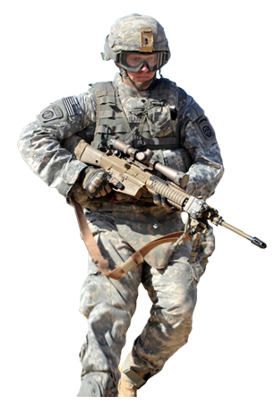

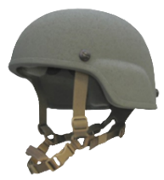
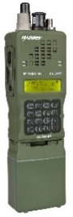
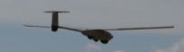
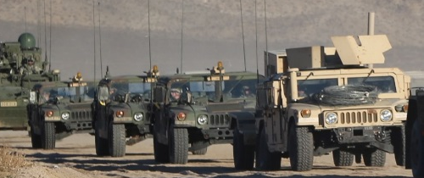
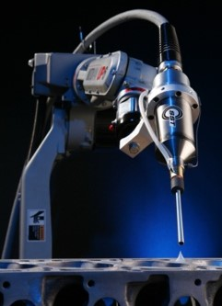
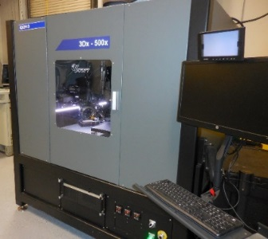
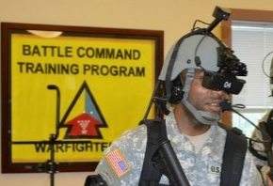
Essential Research Areas
Human-Agent Teaming
Cyber & EM Technologies for Complex Environments
Distributed / Cooperative Engagement in Contested Environments
Artificial Intelligence/ Machine Learning
Manipulate Failure Physics for Robust Materials
Tactical Unit Energy Independence
Manufacturing at the Point of Need
Accelerated Learning for a Ready Force
Discovery
Notes:
Human Agent Teaming: Enable teams of humans and intelligent agents to perform a military-relevant task efficiently yet more effectively than either group alone by leveraging the unique capabilities of each
Artificial Intelligence and Machine Learning: Develop and employ a suite of artificial intelligence and machine learning techniques and systems to assist soldiers in complex operational conditions
Manipulating Physics of Failure for Robust Performance of Materials: Detect, characterize, and manipulate the physics of failure, including fatigue and dynamic damage to create disruptively capable structures that are affordable, available and adaptable.
Science for Manufacturing at the Point of Need: Enable the rapid development and certification of lightweight multi-functional materials technology for protection, maneuver, and situational awareness by enabling new and adaptable manufacturing processes and robust predictive models
Tactical Unit Energy Independence: Exploit the interplay between material properties, structural morphologies, and dynamics of military operations to increase energy density, harvesting from locally available resources and conversion and transmission efficiencies.
Cyber and Electromagnetic Technologies for Complex Environments: Exploit the coupling of the cyber domain and electromagnetic activities to seize and retain operational advantage over adversaries and to deny and degrade enemy capabilities.
Distributed and Cooperative Engagement in Contested Environments: Science that allows a small number of dispersed entities to deliver overwhelming kinetic and non-kinetic effects to deliver efficient payload kill mechanisms; science that allows one to protect a body/platform against complex single and multiple entities
Accelerated Learning for a Ready and Responsive Force: To accelerate learning to help Soldiers reach a higher level of proficiency faster; Research to understand individual differences in learning to develop adaptive training and human augmentation technologies.
Discovery: Army relevant science that we are currently exploring. Examples include foundational work in the Quantum Sciences, Living Materials, and in modeling Complex Systems.

Slide 8
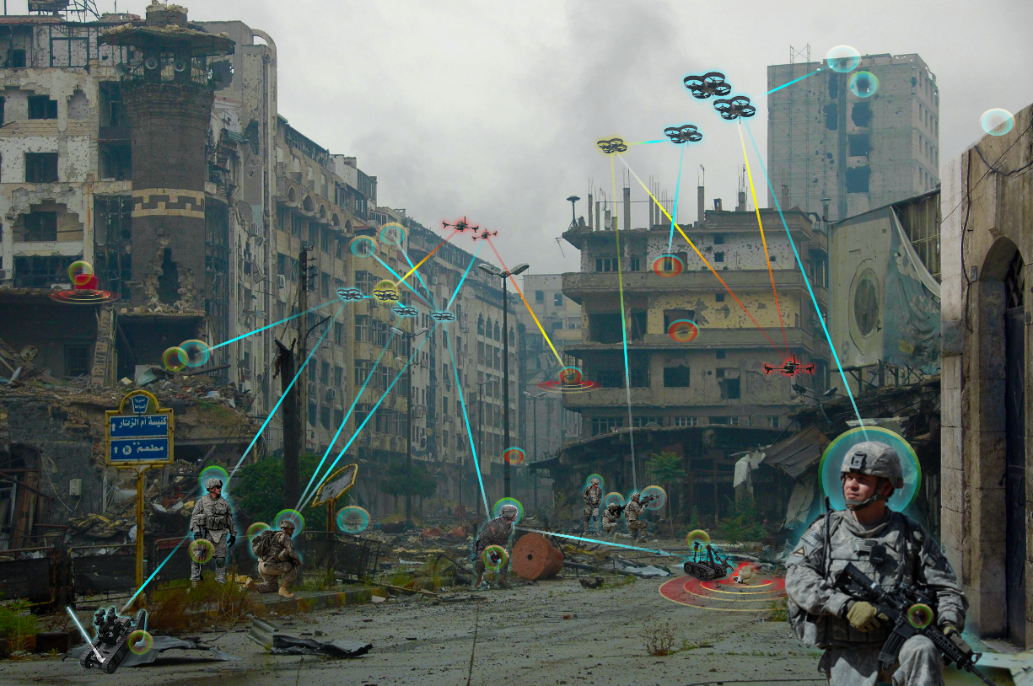
AI & ML ERA Motivational Scenarios
Unified Land Operations → Prevailing in a Complex World
Large-scale, cluttered urban environment
Dynamic in-flight learning &
re-planning at the Speed of the Fight
Learning in new environments with deception from advanced persistent threats
Highly-dispersed team of human & robot agents accessing highly heterogeneous information sources
Notes:
In order to maintain dominance on the battlefield of the future, the Army must address the research challenges in AI&ML highlighted in this motivational scenario. Computational Sciences is leading efforts in order to achieve AI&ML at the point of need in resource constrained environments (SWaP-T). Additionally, new ML methods and algorithms are required for adaptive AI in a dynamic, congested, contested environment.

Slide 9
AI & ML ERA Vision and Gaps
Vision:
Develop and employ a suite of artificial intelligence (AI) and machine learning techniques and systems to assist soldiers in complex operational conditions.
Gaps
AI & ML with small samples, dirty data, high clutter
AI & ML with highly heterogeneous data
Adversarial AI & ML in contested,
deceptive environment
Distributed AI & ML with limited
communications
AI & ML computing with extremely
low SWaPT
Explainability & programmability
for AI & ML
AI & ML with integrated quantitative
models
Learning in
Complex Data
Environments
Resource-constrained
AI Processing
at the Point-of-Need
Generalizable
& Predictable AI

Slide 10
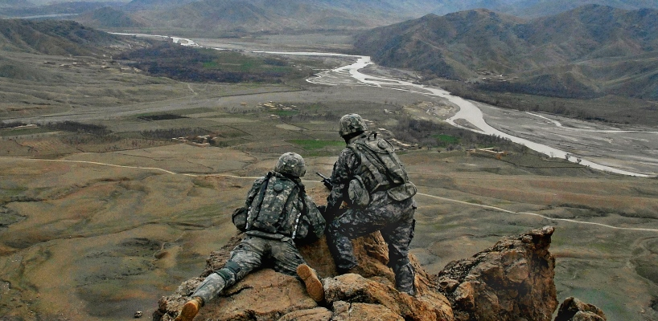
Army Needs Real Time Response …
The Soldier is Our Customer
… (at low power)
Challenges to widespread sensor deployment
Large areas with sparse or no fixed network infrastructure
Unreliable network access and limited bandwidth
Power constrained environment
➔ Need low-power advanced computing at the data source

Slide 11
Computational Sceicnes
Research
Advanced scalable algorithms
Multi-disciplinary
Challenge
Domain Specific Low power architecture
Cognitive Networking
Nano-technologies
Possible Path Forward

Slide 12
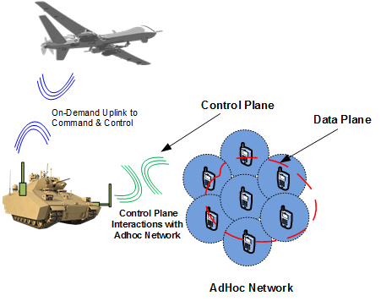


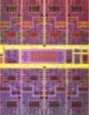
Network Intelligence
Networks are application aware and vice versa
Unified forwarding and Security Policy enforcement
Software driven network intelligence – hardware agnostic
Silicon Photonics Plane
Memory
Plane
Processor Plane
Programmable control plane for tactical wireless networks
S. J. Ben Yoo UC Davis

Slide 13
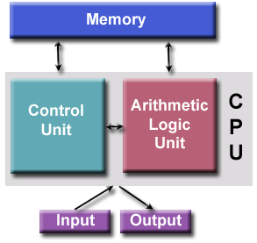
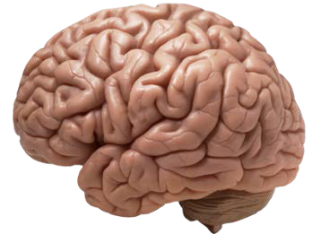




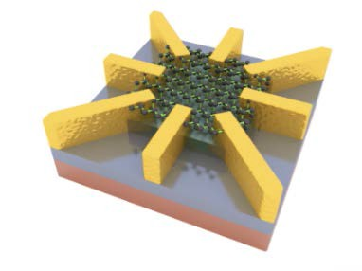
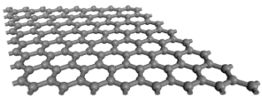
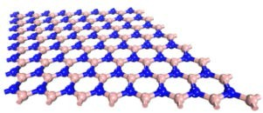

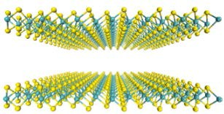
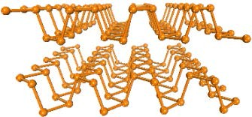
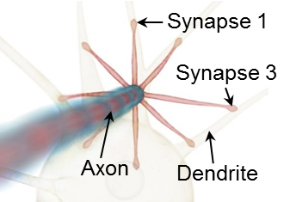
Low Power Computing
von Neumann Computing System
Human Brain
v.s.
1.4 MW (>500 times average household power consumption), 8192 processors, 10⁹ synaptic events/sec (10⁹ flops)
10 W, 10¹⁵ synapses, 10¹¹ neurons,
10¹⁶ synaptic events/sec
Neuromorphic electronics (and our biological brain) and stochastic computing:
Memory and computation are realized in synapses and neurons in a highly parallel way.
Inadequacy of the Existing Technology
Circuit Approach: Single synapse need 10-12 transistors, the scale could never reach the human brain scale. limit in complexity, power consumption..
Graphene
hBN
Device Approach: FET based, oxide
memristor phase change memory and
STT-RRAM.
Need new device concepts
MoS₂
Black Phosphorus
2D Materials offer a rich array of very unique physical properties that are particularly attractive for developing novel device functionalities that can mimic the operations of synapses, which is the key building block for biological brain.

Slide 14

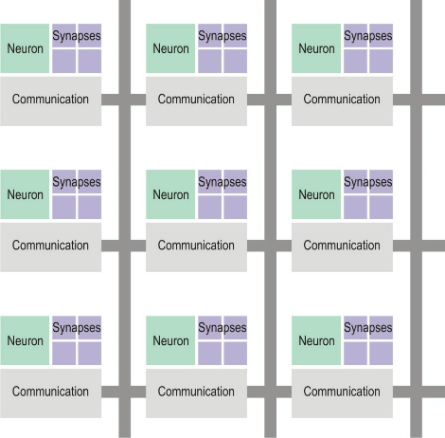

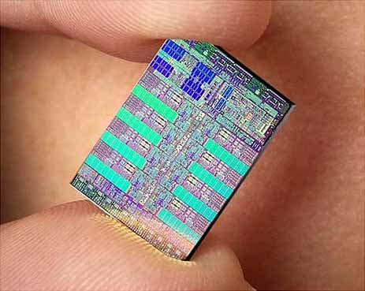
Heterogeneous Computing
Next Generation Computing
Concept
Von Neumann Architecture
Non-Von Neumann
Architecture
Source: https://www.quora.com/How-does-the-
Von-Neumann-architecture-provide-flexibility-for-
program- development
Source: https://www.extremetech.com/extreme/187612-ibm-cracks-open-a-new-era-of-computing-with-brain-like-chip-4096-cores-1-million-neurons-5-4-billion-transistors
Logical
Analytical
Objective
Look at parts
R
Random
Intuitive
Subjective
Look at wholes
L

Slide 15
What Next ?
The future of Low power heterogeneous computing paradigm is very promising due to developments in brain-inspired computing, nano-technologies, materials, and cognitive networking.
Increased interdisciplinary efforts from the larger research community could further amplify potential.
DoD is confident that leveraging relationships with industry and academia will help overcome these obstacles.

Slide 16
ARL Central
Under Development
Advanced Photon Source
CRA - Cyber Security
Research Alliance
Old Main State College, PA
ARO-London
co-located with
RFEC-ATLANTIC
ARO-Tokyo
co-located with
RFEC-PACIFIC
ARL North East
Under Development
ISN - Cambridge, MA
CTA - Network Sciences
Cambridge, MA
ARL - Aberdeen Proving Ground
CRA - Multi-Scale Multidisciplinary Modeling of Electronic Materials
Salt Lake City, Utah
ARL - Adelphi Laboratory Center (HQ)
CRA - Materials in Extreme Dynamic Environments
Baltimore, Maryland
ICB - Santa Barbara, CA
CTA - Micro Autonomous Systems and Technology (MAST)
Washington, D.C.
Playa Vista, CA
ARL West
CTA - Robotics
Falls Church, VA
ICT - Playa Vista, CA
White Sands Missile Range
CTA - Cognition & Neuroergonomics
Alexandria, VA
ARL Primary Labs Site
ARL Field Element
Collaborative Alliances
Open Campus Hub
Collaboration Spoke
International Hub
ARO-Brazil
co-located with
RFEC-AMERICAS
ARL - Orlando, FL
ARL – ARO- RTP, NC
ARL South
Austin, TX

Slide 17
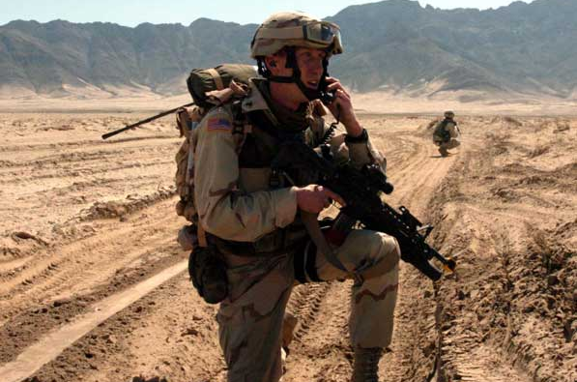

Excellence in Science & Technology
_{QUESTIONS?}
raju.r.namburu.civ@mail.mil

