Slide 1
BigData Express: Toward Predictable, Schedulable, and High-Performance Data Transfer
Wenji Wu, Fermilab
SC’19, Denver
November 14, 2019

Slide 2
Acknowledgments
This work was supported by the U.S. DOE Office of Science ASCR network research program

Slide 3

BigData Express
BigData Express: a schedulable, predictable, and high-performance data transfer service
  A peer-to-peer, scalable, and extensible data transfer model
  A visually appealing, easy-to-use web portal
  A high-performance data transfer engine
  A time-constraint-based scheduler
  On-demand provisioning of end-to-end network paths with guaranteed QoS
  Robust and flexible error handling
  CILogon-based security (certificate version)
  A rich set of REST APIs to support scientific workflows

Slide 4
BigData Express Major Components
BigData Express Web Portal
  Access to BigData Express services
BigData Express Scheduler
  Time-constraint-based scheduler
  Co-scheduling DTN, storage, & network
AmoebaNet
  Network as a service
  Rate control
mdtmFTP
  High-performance data transfer engine
  http://mdtm.fnal.gov
DTN Agent
  Manage and configure DTNs
  Collect & report DTN configuration and status
Storage Agent
  Manage and configure storage systems
  I/O estimation
Data Transfer Launching Agent
  Launch data transfer jobs
  Support different data transfer protocols
Notes:
1. BDE Web Portal
- Providing a visual interface to allow users to submit data transfer requests and obtain data transfer status
- Launching data transfer tasks on users/applications’ behalves
- Providing HTTPS communication channels among BigData Express sites to support BigData Express mechanisms
- Allowing system admins to manage and monitor BigData Express sites
- A common single-point sign-on service - CILogon service – to obtain X.509 certificates for secure access to BigData Express sites
2. BDE Scheduler
Orchestrate resources at local sites
DTNs
Storage
Local network resources
Negotiate and broker resources with remote sites
3. AmoebaNet
A SDN-enabled network service that provide “Application-aware” network
Allow application to program network at run-time for optimum performance
Network as a service
Note: SDN is software defined networking.
Originally designed for BigData Express. Can be independently deployed to support any applications
AmoebaNet key features:
Providing AMQP interface to allow application to program network at run-time for optimum performance
JSON-RPC style communication
Dynamic and flexible interaction with network
Qos-based routing and path calculation
Bandwidth
Delay
Fast provisioning end-to-end network path with guaranteed Qos
VLAN-based layer-2 path
TCP/IP-based layer-3 path
REST-based network initialization and configuration
4. mdtmFTP is a high performance data transfer tool developed by FNAL network research group
Pipelined I/O-centric design to streamline data transfer
Multicore-aware data transfer middleware (MDTM) optimizes use of underlying multicore system
Extremely efficient in transferring of Lots Of Small Files
Various optimization mechanisms
Zero copy
Asynchronous I/O
Batch processing

Slide 5
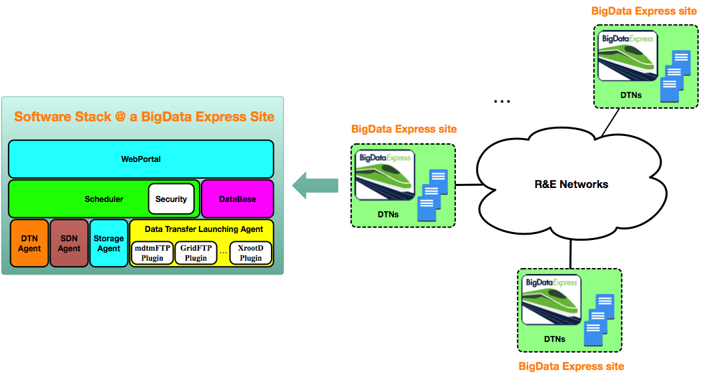
BigData Express -- Distributed
A Peer-to-Peer model
Notes:
BigData Express adopts a distributed, peer-to-peer model. A BigData Express site can independently provide data transfer service.
Essentially, BigData Express orchestrates resources (DTNs, storage, and networking) within a site, and negotiates/brokers resources across sites.

Slide 6
BigData Express -- Flexible
Flexible to set up data transfer federations
Providing inherent support for incremental deployment
Notes:
BigData Express is flexible to set up various data transfer federations.

Slide 7
BigData Express -- Scalable
BigData Express scheduler manages site resources through agents
Use MQTT as message bus
Notes:
BigData Express has a scalable software architecture.
At a BigData Express site, BigData Express scheduler manages site resources through various agents
DTN agents
SDN agents
Storage agents
Data transfer launching agent
Use MQTT as message bus to enable communication between BigData Express scheduler and agents

Slide 8
BigData Express -- Extensible
Extensible Plugin framework to support various data transfer protocols
  mdtmFTP, GridFTP, XrootD, …

Slide 9
BigData Express -- End-to-End Data Transfer Model
Application-aware network service
  On-demand programming
Fast-provisioning of end-to-end network paths with guaranteed QoS
Distributed resource negotiation & brokering
Notes:
BigData Express intelligently programs networks at run-time to suit data transfer requirements, It fast provisions end-to-end network paths with guaranteed QoS.
BigData Express typically performs the following operations to provision an end-to-end network path:
Estimate and calculate DTN-to-DTN traffic matrix, and the related QoS requirements (e.g. throughput, delay).
Calculate site-to-site traffic matrix, and the related QoS requirements (e.g., throughput, delay).
Call ESnet OSCARS or Internet2 AL2S circuit service to set up or modify point-to-point layer 2 circuits between sites.
Call AmoebaNet at each site to program LAN or campus network. Traffic between systems in physically disperse sites are multiplexed/de-multiplexed to/from the corresponding point-to-point layer 2 circuits between sites.

Slide 10
mdtmFTP
A high-performance data transfer tool
Pipelined I/O-centric design to streamline data transfer
Multicore-aware data transfer middleware (MDTM) optimizes use of underlying multicore system
Extremely efficient in transferring of Lots Of Small Files
Various optimization mechanisms
  Zero copy
  Asynchronous I/O
  Batch processing
A DOE/SC/ASCR-sponsored research project
Software is available at: http://mdtm.fnal.gov

Slide 11
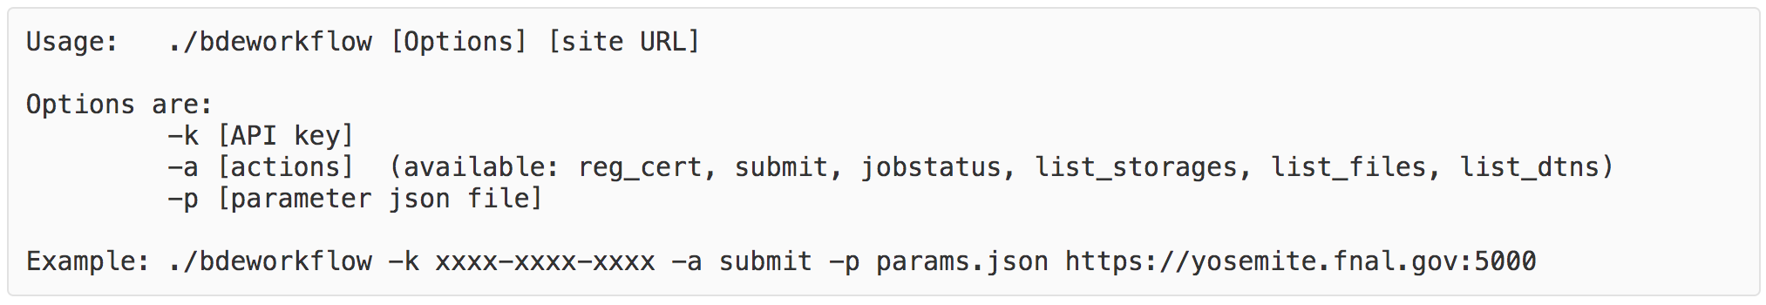
BigData Express – Development Package
A command line tool called “bdeworkflow” is provided
  to invoke BigData Express REST APIs
A rich set of REST APIs to provide the BigData Express services
Ready to support scientific workflows!

Slide 12






BigData Express SC19 DEMO

Slide 13

BigData Express – Deployment
Asia
  KISTI, South Korea
  KSTAR
Europe
  University of Amsterdam, Netherlands
North America
  Fermilab
  StarLight, Northwestern University
  UMD/MAX, University of Maryland, College Park
  Ciena (Canada)
    US East
    CA East
Australia & Pacific areas
  National Computational Infrastructure (NCI)

Slide 14
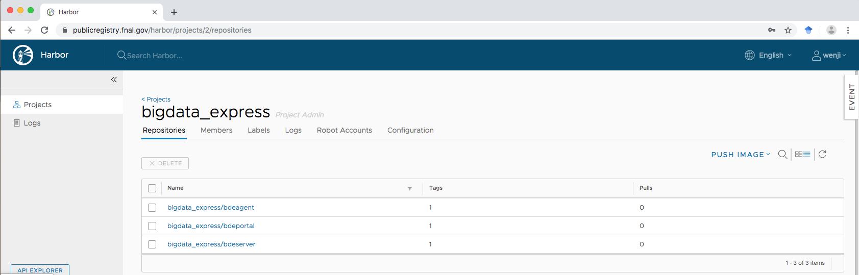
BigData Express Release
License
  Apache 2.0
Docker release
  Repository
    publicregistry.fnal.gov
  Docker images
    bdeagent:1.5-xenial
    bdeserver:1.5-xenial
    bdeportal:1.5-xenial
  Pull instruction
    https://bigdataexpress.fnal.gov/Releases.html
Source code package release
  Available

Slide 15
BigData Express Documents
BigData Express Admin Manual
  https://bigdataexpress.fnal.gov/admin_manual/index.html
BigData Express Design and Architecture
  https://bigdataexpress.fnal.gov/design_manual/index.html
BigData Express Web Portal User Manual
  https://bigdataexpress.fnal.gov/portal_manual/index.html

Slide 16
More information about BigData Express
http://bigdataexpress.fnal.gov
Contact: wenji@fnal.gov
This document was prepared by BigData Express using the resources of the Fermi National Accelerator Laboratory (Fermilab), a U.S. Department of Energy, Office of Science, HEP User Facility. Fermilab is managed by Fermi Research Alliance, LLC (FRA), acting under Contract No. DE-AC02-07CH11359.

